Slide 1



Slide 2

Team No : 2
20KP1A4404 – YAMINI
20KP1A4456 – VISHNU
20KP1A4437 – SOWMYA
20KP1A4447 – IRFAN

Slide 3
ABSTRACT :
The aim of this project is to analyze the sentiments of expressed in tweets, categorizing them as positive , negative or neutral. The data will consists of Twitter data, and the analysis will provide insights into public opinions ,trendsand emotions on different topics. The project contributes to the field of social media analytics and showcases the practical application of machine learning in understanding sentiment patterns on a large scale.
Sentimental analysis is a fast track area of research in high demand for business giving them the ability to understand and adapt their business stratagies. This research contributes to the application of machine learning in business intelligence,fostering a more informed and responsive approach to customer satisfaction and market trends.

Slide 4
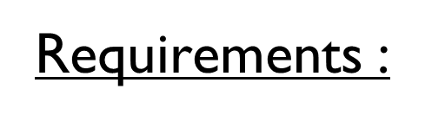

Software Requirements :
Programming Language :
Python : Widely used for Machine learning and natural language processing
Libraries and Frameworks :
TensorFlow for machine learning algorithms
Pandas and Numpy for data manipulation and analysis
Visualization :
Data visualization to gain insights from the analyzed sentiments
Web Frameworks :
Django for creating a web-based interface to interact with the sentiment analysis system
Cloud Services
AWS,Microsoft Azure for cloud-based storage,computing and deployment

Slide 5

Hardware Requirements :
Processor (CPU) : A muti-core processor for efficient parallel processing during data preprocessing and model training
Random Access Memory(RAM) : 8GB of RAM to handle the data processing and model train tasks effectively
Storage : To store collected Twitter data,preprocessing data ans machine learning model files
Network Connection : Internet connection for accessing the Twitter API,downloading datasets and potentially deploying the model on cloud platforms
Operating System(OS) : Compatible with windows ,Linux,depending on the preferred development environment and toolset
Backup and Redundancy : Backup system for critical data,and consider redundancy for continuous availability in case of hardware failures

Slide 6
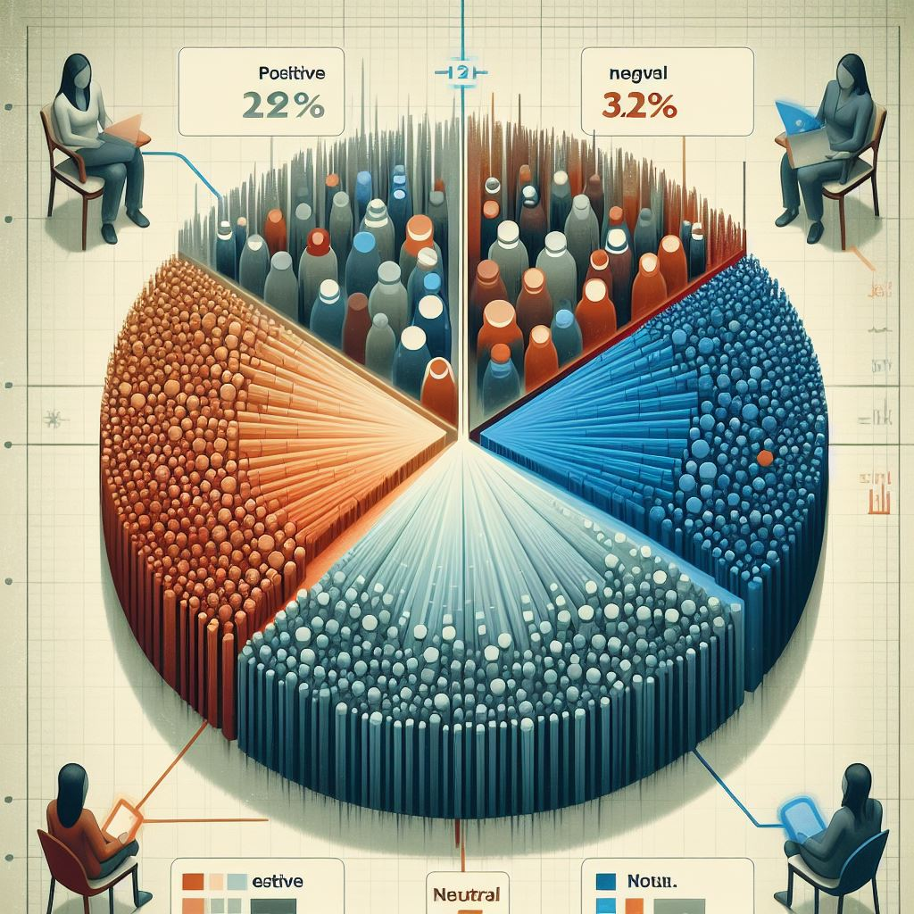

Existing System:
Data collection : Collect a large dataset of tweets related to business
Preprocessing : Clean and Preprocess the data by removing special characeters etc.,,
Sentiment Analysis : used to sentiment of each tweet as positive,negative or neutral.
Real-time monitoring : System provides real-time monitoring of sentiment trends on twitter.
Evaluation : Evaluate the performance of model using metrics like accuracy and precision.
Customization : For customer satisfaction and their specific goals and needs.
Reporting : To visualize sentiment data and share insights with stakeholders.

Slide 7
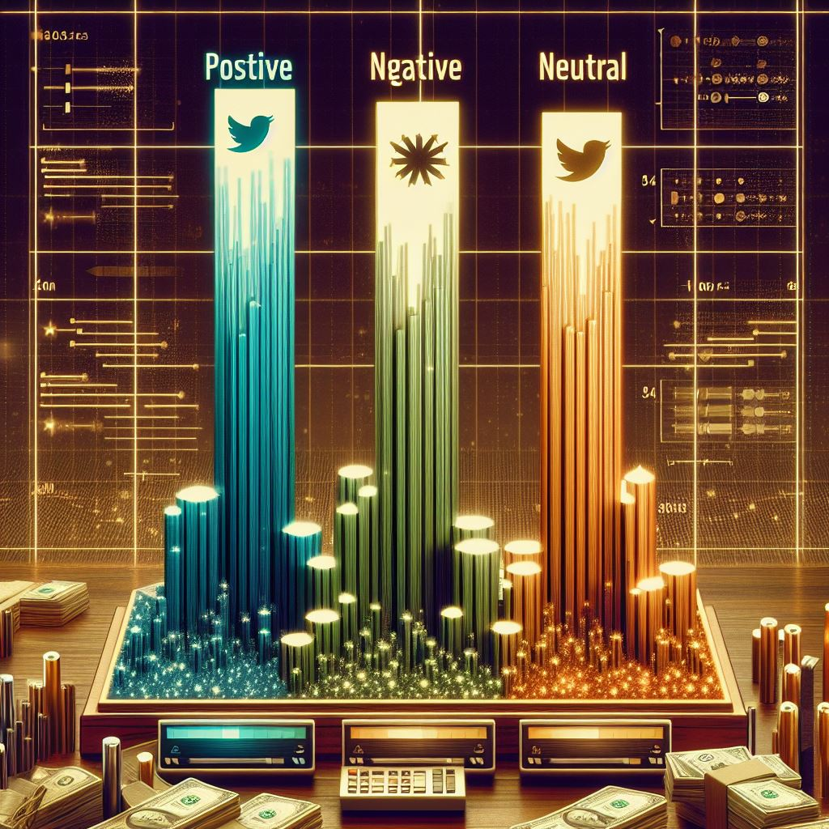
Proposed System
Training : Train the sentiment analysis model on labeled data to learn patterns and relationships
Evaluation : Assessing the performance of the trainedmodel using metrics like accuracy recalls etc,,.
Deployment : The trained model into a production environment where it can analyze new tweets in real-time
Integration with Business Strategies : It results the sentiment analysis results with business strstegies such as adjusting marketing campaigns,product development.
Dashboard Visualization : Create dashboard to visualize sentiment trends over time and provide actionable insights to business stakeholders.

Slide 8
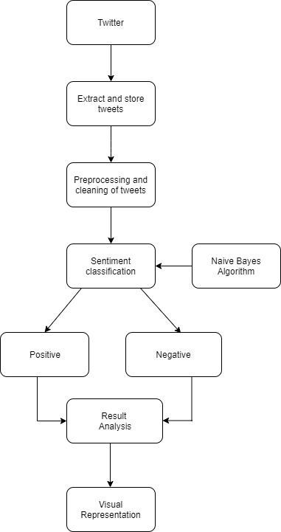
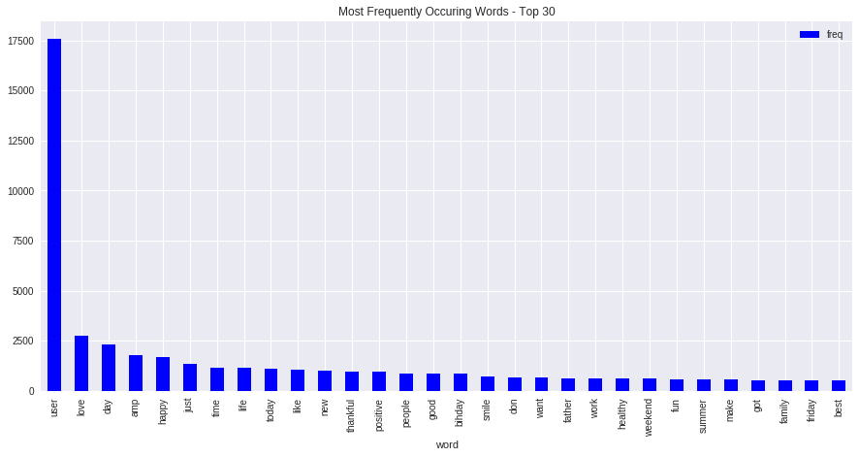
Data Flow Diagram

Slide 9
Existing Data Flow Diagram
Twitter
Data
Extrat and store tweets
Preprocessing and cleaning of tweets
Sentiment classification
Positive
Negative
Result Analysis
Visual Representation

Slide 10
Proposed Data Flow Diagram
Twitter
Data
Extrat and store tweets
Preprocessing and cleaning of tweets
Naive Bayes
Sentiment classification
Tokenization of tweets
Support Vector Machine algorthim
Positive
Neutral
Negative
Happy
Sad
Result Analysis
Visual Representation
Result Analysis

Slide 11
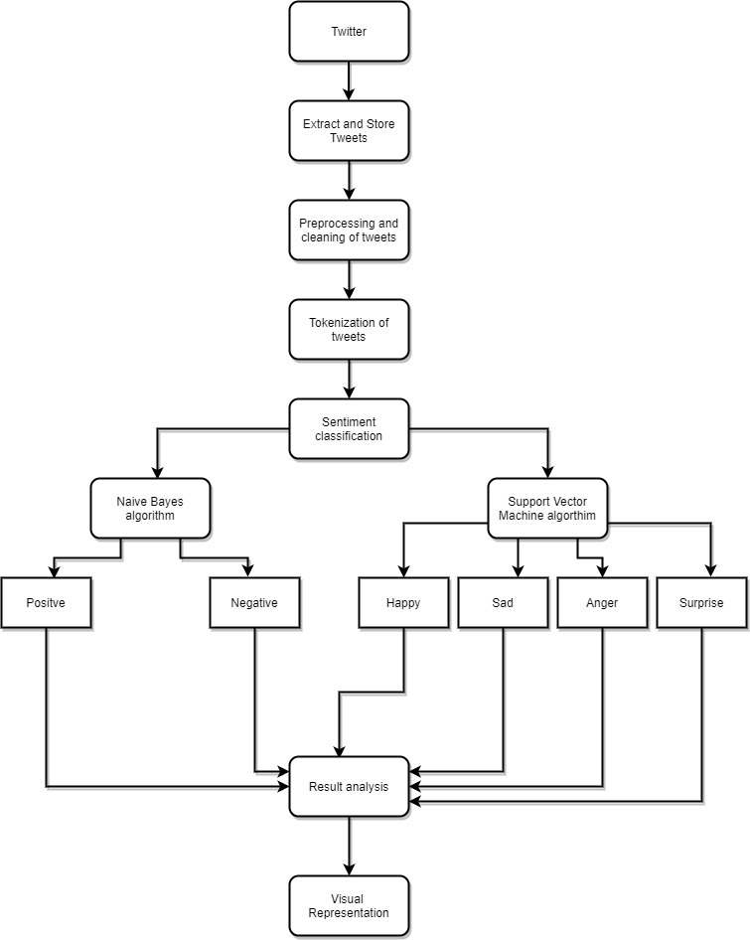
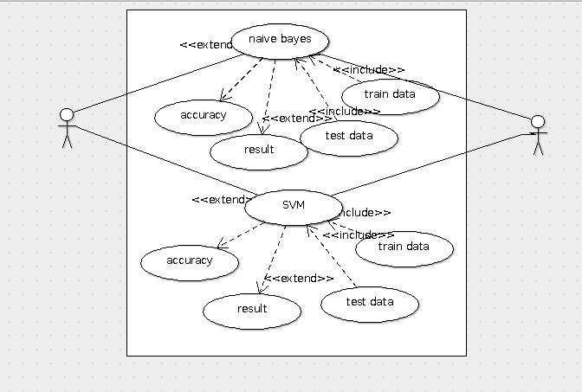
Use Case Diagram :

Slide 12

Modules used :
Tweepy : It is python library for accessing the twitter API
NLTK : natural Language Tool Kit : Used to build python program
TensorFlow/Keras : It is open source machine learning framework developed by google
Gensim : It is python library for topic modeling
Pandas : It is analysis library for python
Matplotlib : It is a ploting library for python

Slide 13

Methodologies used
Supervised Learning : Navie Bayes,Logistic Regression
Unsupervised Learning : K-means clustering and Non-negative Matrix Factorization.
Hybrid Learning : Domain knowledge Integrate sentiment lexicons
Temporal Analysis : Time series analysis and time series decomposition

Slide 14

Protocols
Oauth(Open Authorization) : Used for authenticating and accessing the Twitter API
HTTP/HTTPS(Hypertext Transfer protocol/secure) : Used for communication between project application and Twitter API
REST(Representational State Transfer) : For interacting with Twitter API
JSON(JavaScript object Notation) : Tweets and user data retrieved from Twitter API
Unicode : Ensure proper handling and representation of text data from tweets

Slide 15
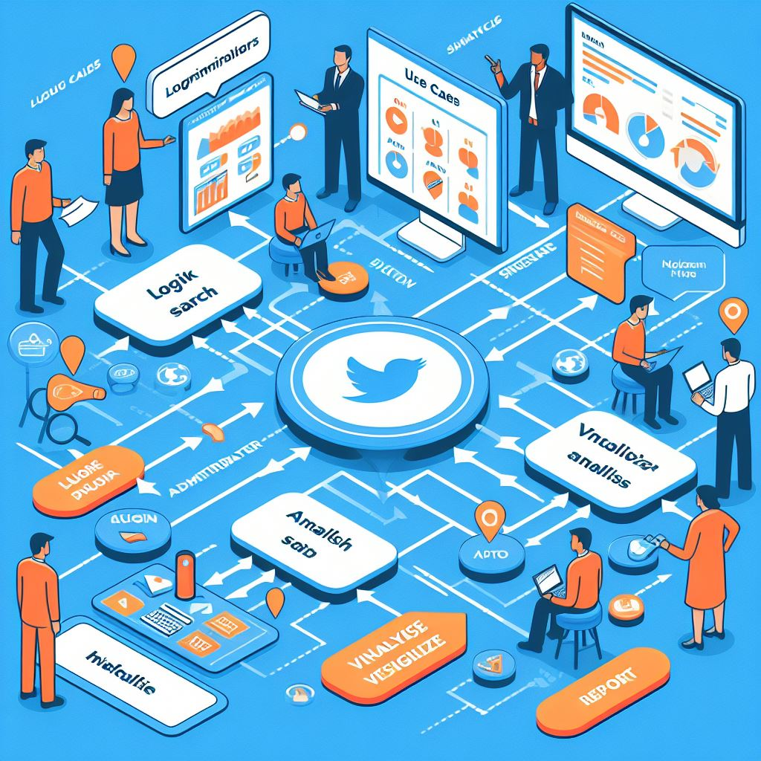
Algorithms :
import numpy as np
import pandas as pd
import matplotlib.pyplot as plt
import seaborn as sns
import warnings
train = pd.read_csv('drive/My Drive/Projects/Twitter Sentiment/train_tweet.csv')
test = pd.read_csv('drive/My Drive/Projects/Twitter Sentiment/test_tweets.csv')
print(train.shape)
print(test.shape)
train.head()
test.head()
train.isnull().any()
test.isnull().any()
train[train['label'] == 0].head(10)
# checking out the postive comments from the train set
train[train['label'] == 1].head(10)
train['label'].value_counts().plot.bar(color = 'pink', figsize = (6, 4))
length_train = train['tweet'].str.len().plot.hist(color = 'pink', figsize = (6, 4))
length_test = test['tweet'].str.len().plot.hist(color = 'orange', figsize = (6, 4))

Slide 16
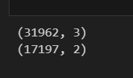
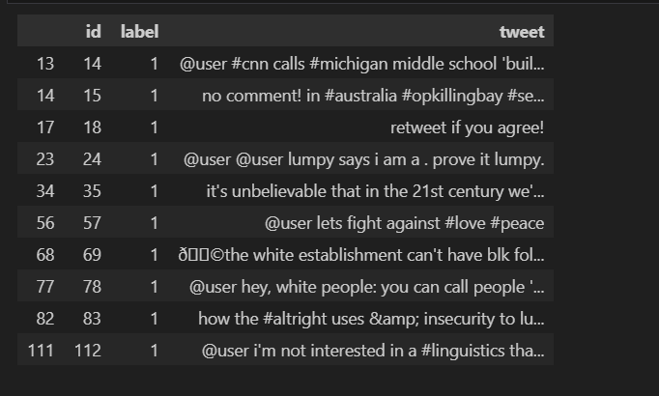
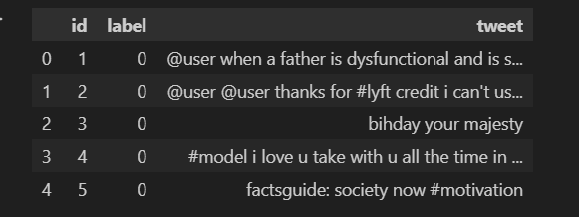
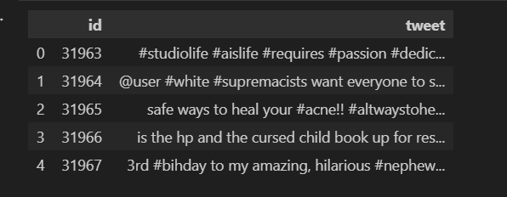
Out Puts

Slide 17
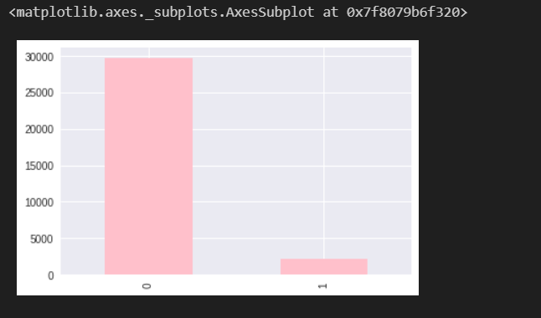
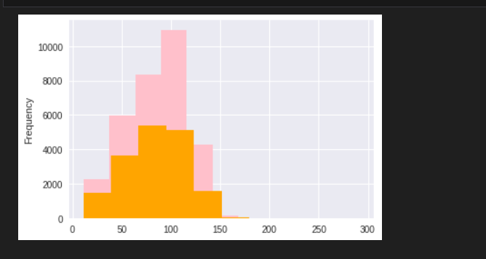

Slide 18

Conclusion
Twitter Sentiment Analysis is a swift and insightful tool that deciphers public emotions on the platform. Through advanced algorithms and a user-friendly interface, it efficiently categorizes tweets into positive, negative, or neutral sentiments in real time. This adaptable system ensures scalability to handle varying tweet volumes and actively evolves through a feedback loop, incorporating user input for continuous improvement. With a keen focus on privacy measures, the analysis provides valuable, up-to-the-minute insights into the dynamic landscape of social media conversations. Its utility extends to businesses and decision-makers, offering actionable data for informed and timely decision-making based on the ever-changing trends in public sentiment on Twitter.

Slide 19

Thank you

